Slide 1
Data Science with Python

Slide 2
Machine Learning with Scikit–Learn
Notes:
Hi! Welcome back! In this lesson offered by Simplilearn, I will take you through machine learning, its algorithms, and how Scikit-Learn makes it all so easy for you.

Slide 3

Learning Objectives
By the end of this lesson, you will be able to:
Define machine learning
Explain the machine learning approach
List relevant terminologies that help you understand a dataset
Discuss features of supervised and unsupervised learning models
Explain algorithms, such as regression, classification, clustering, and dimensionality reduction
Notes:
In this lesson, you will get to know what machine learning is and why it is important. You will also be introduced to the machine learning approach and learn each of its steps in detail. You will learn relevant terminologies of machine learning and figure out how you can understand a dataset using these terms. You will look at the two major machine learning models: supervised and unsupervised models. Within these models, you will be specifically learning about regression, classification, clustering, and dimensionality reduction algorithms.

Slide 4
Introduction to Machine Learning

Slide 5
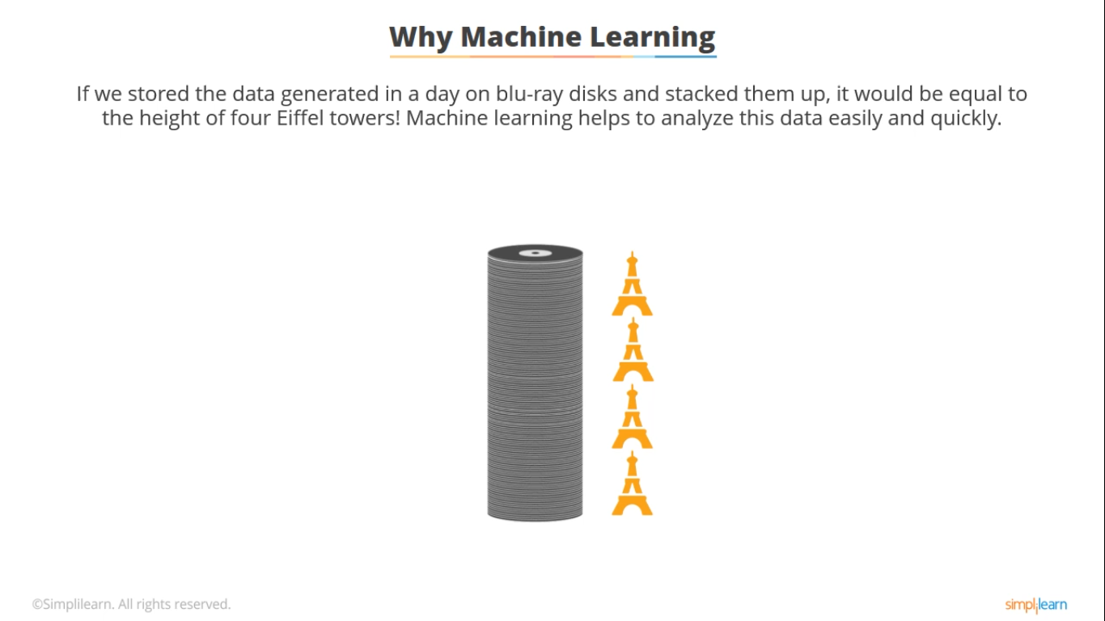
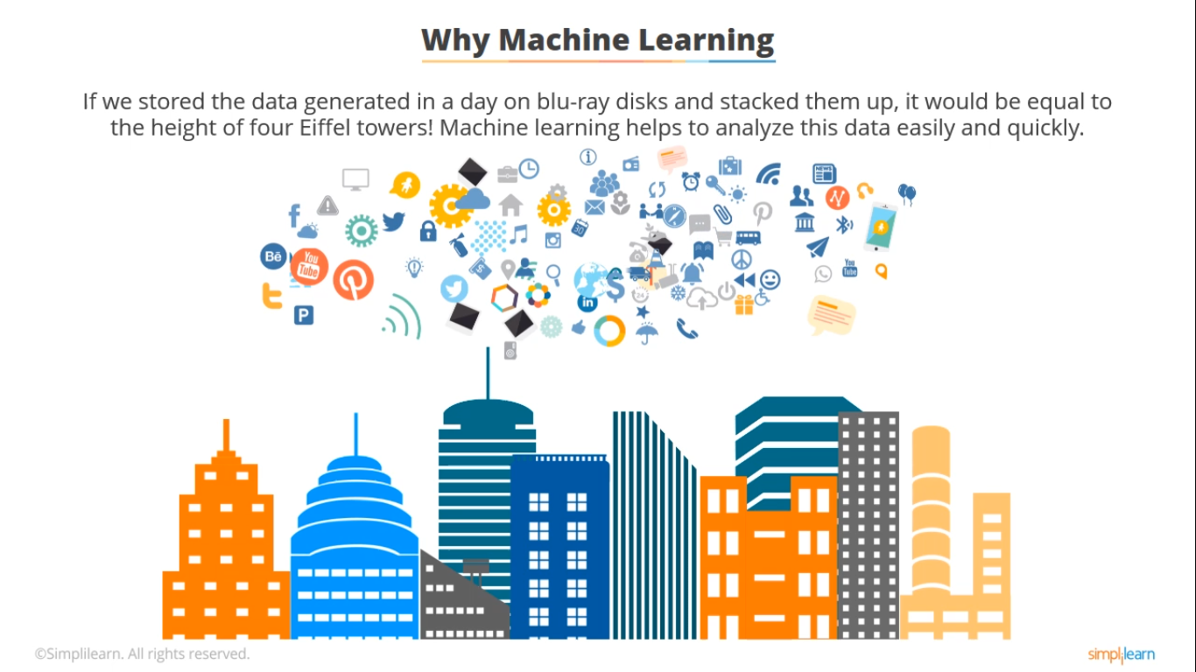

Why Machine Learning
If we stored the data generated in a day on Blu-ray disks and stacked them up, it would be equal to the height of four Eiffel towers. Machine learning helps analyze this data easily and quickly.
Machine learning
Notes:
We generate 2.5 quintillion bytes of data every day! That’s equal to data stored on 100 million Blu-ray disks, which when stacked together, is equal to the height of 4 Eiffel towers! And none of this data is in a single format. Now imagine, if you had to sit there and manually sift through all of it. It would take ages!
But if you let the machines take over, the task would be over in a jiffy. This is why we need machine learning.

Slide 6

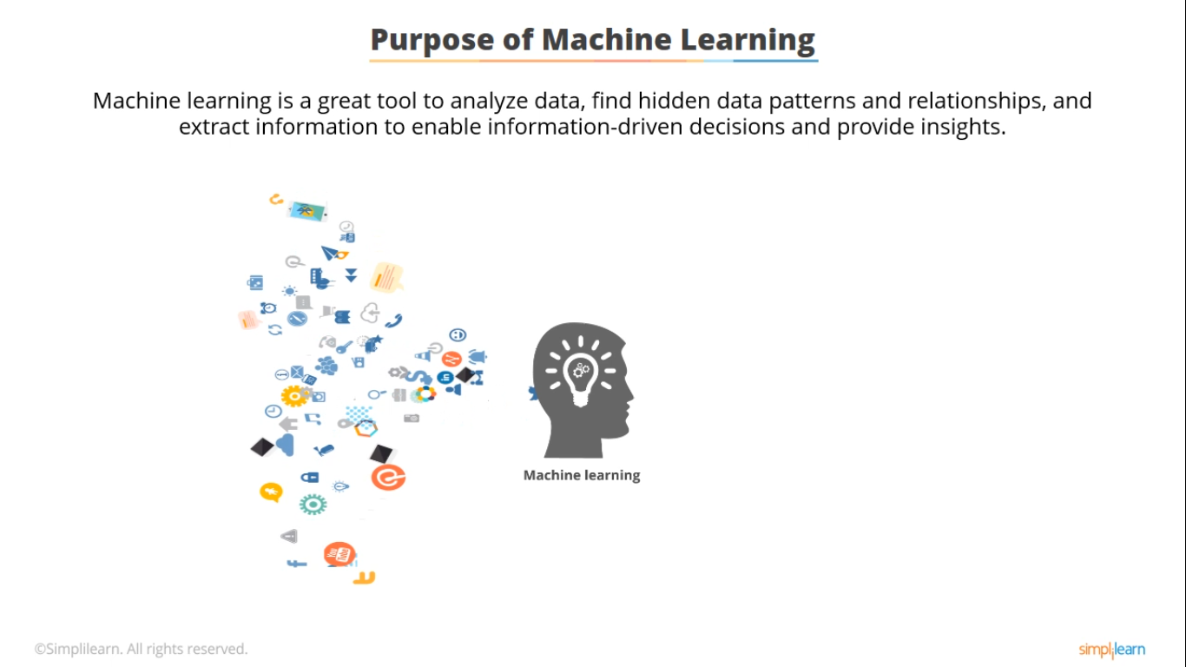
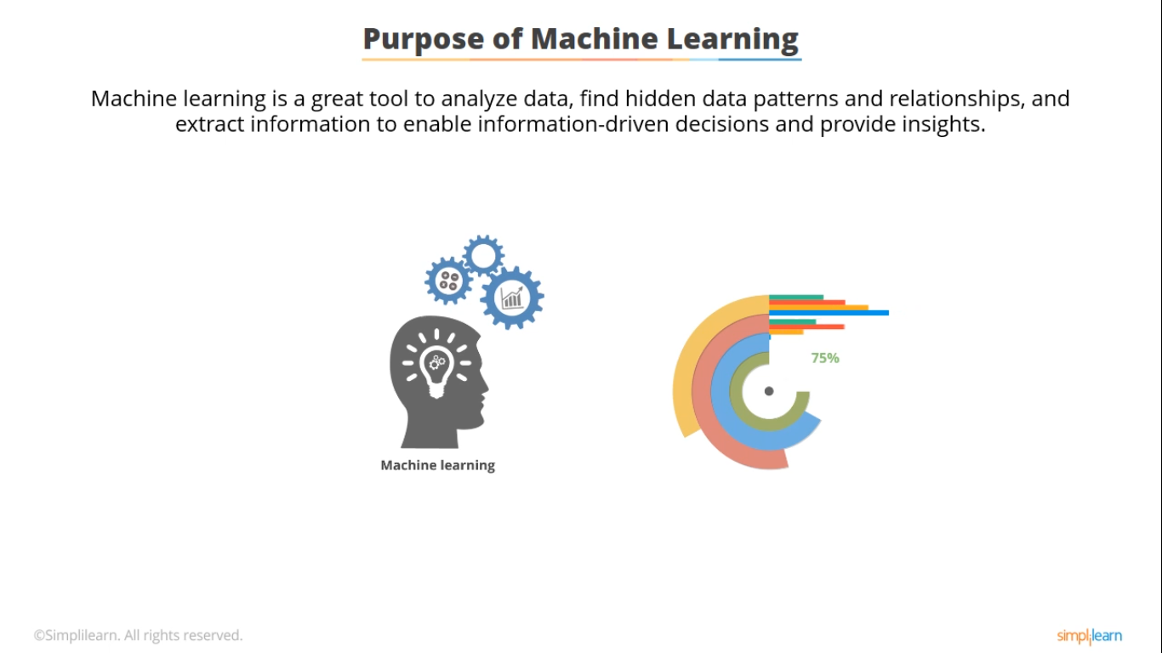


Purpose of Machine Learning
Machine learning is a great tool to analyze data, find hidden data patterns and relationships, and extract information to enable information-driven decisions and provide insights.
Identify patterns and
relationships
Data
Gain insights into unknown data
Take information-driven decisions
Notes:
Machine learning is a great tool to analyze data, find hidden data patterns and relationships, and extract information. This enables Data Scientists to make information-driven decisions.
Even businesses can benefit from it. A business may have a lot of historical or incoming data that they are not aware of. Machine learning can help provide insights into this data, so that profitable decisions can be made and new business opportunities can be explored.
To do all of this, machine learning uses statistical and mathematical models, and applies them to datasets. This process can either be semi-automated or fully automated.

Slide 7



Machine Learning Terminology
These are some machine learning terminologies that you will come across in this lesson:
Inputs
Attributes
Features
Label
Records
Response
Observations
Outcome
Examples
Target
Samples
Notes:
You now know what machine learning is and what it is useful for. Now, before you learn more about it, take a look at some machine learning terminologies that will be used throughout this lesson.
Observations are the records, samples, or examples present in the dataset. They may contain one or more data points.
Features are the inputs or attributes that define a given dataset. They are usually present as columns in a spreadsheet.
Response is the label, outcome, target, or some defined answer attached to the dataset for the given set of data points.
I will explain these terms later using a dataset, but before that, let’s look at the machine learning approach.

Slide 8
Machine Learning Approach

Slide 9
Machine Learning Approach
The machine learning approach starts with either a problem that you need to solve or a given dataset that you need to analyze.
Strive for accuracy
Train and test the model
Choose the right model
Identify the problem type
Extract the features from the dataset
Understand the problem/dataset
Notes:
The machine learning approach starts with either a problem that you need to solve or a given dataset that you need to analyze. So, your first step is to understand the problem or the dataset. The size of the dataset does not matter at this point.
The next step is to identify and extract the features of the dataset that affect the outcome.
Then, identify its problem type. For instance, you may want to ask whether the data is categorical or has some continuous set of values.
Based on the problem type, choose the appropriate model. Don’t worry about this right now; you will be learning about them later in this lesson.
After selecting the model, train and test it.
The final step is to strive for accuracy. You should continue to fine tune the parameters so that your model performs optimally.

Slide 10
Steps 1 and 2: Understand the Dataset and Extract Its Features
Let us look at a dataset and understand its features in terms of machine learning.
Features (attributes)
Response (label)
Education (Yrs.) | Professional Training (Yes/No) | Hourly Rate (USD)
16 | 1 | 90
15 | 0 | 65
12 | 1 | 70
18 | 1 | 130
16 | 0 | 110
16 | 1 | 100
15 | 1 | 105
31 | 0 | 70
Observations
(records)
Predictors
Notes:
Let’s now explore the first couple of steps of the machine learning approach: Understanding the dataset and extracting its features that affect the outcome.
This is a dataset which contains information of a XYZ firm. It shows random records of some of its employees. These are called observations.
Education and professional training are attributes. The first attribute indicates the employees’ number of years of education, while the second attribute shows how many of them actually took some professional training.
Now, the years of education and the professional training of the employees affect their salaries. That’s why the hourly rate is the response or outcome of the dataset.
Using this data, you can now predict that a person with 16 years of education and some professional training can fetch an average of 100 US dollars per hour.

Slide 11
Steps 3 and 4: Identify the Problem Type and Learning Model
Machine learning can either be supervised or unsupervised. The problem type should be selected based on the type of learning model.
Concept
Problem Types
Example
Supervised Learning
Unsupervised Learning
In supervised learning, the dataset used to train a model should have observations, features, and responses. The model is trained to predict the “right” response for a given set of data points.
Supervised learning models are used to predict an outcome.
The goal of this model is to “generalize” a dataset so that the “general rule” can be applied to new data as well.
In unsupervised learning, the response or the outcome of the data is not known.
Unsupervised learning models are used to identify and visualize patterns in data by grouping similar types of data.
The goal of this model is to “represent” data in a way that meaningful information can be extracted.
Notes:
Steps 3 and 4 involve identifying what the type of the problem is and which model is best suited to solve it. Machine learning can either be supervised or unsupervised. Based on that, the appropriate problem type should be selected.
You have already seen the dataset for XYZ firm, which had observations, features, and response. In supervised learning, all three of them are used to create and train a model to predict the “right” response for a new set of data points with similar features. Its main objective is to predict the outcome by generalizing the data and applying the generalized rule to the new data points.
In unsupervised learning, the response or the outcome of the data is not known. Here, we try to identify patterns in the data by grouping similar types of data. Note that there is no definite or right answer. The goal of unsupervised learning models is to represent data in a way that meaningful information can be extracted.

Slide 12
Steps 3 and 4: Identify the Problem Type and Learning Model
Data can either be continuous or categorical. Based on whether it is supervised or unsupervised learning, the problem type will differ.
Concept
Problem Types
Example
Supervised Learning
Unsupervised Learning
Data
Data
Data Type
Data Type
Continuous
Categorical
Continuous
Categorical
Regression
Classification
Problem Type
Dimensionality reduction
Clustering
Problem Type
Notes:
Data can either be continuous or categorical. Based on whether it is supervised or unsupervised learning, the problem type will differ.
Continuous data is information which can be measured and has infinite number of possible values. For example, age, salary, price, temperature, and so on.
Categorical data is information which can be grouped or labeled, such as gender, face recognition, or spam detection.
For supervised learning, use the regression algorithm if the data is continuous. Use the classification machine learning when the data is categorical.
For unsupervised learning, use dimensionality reduction for continuous data. This method reduces the dimensions of dataset without any loss of data. Clustering is mainly used for categorical data and is used to group similar data points.

Slide 13
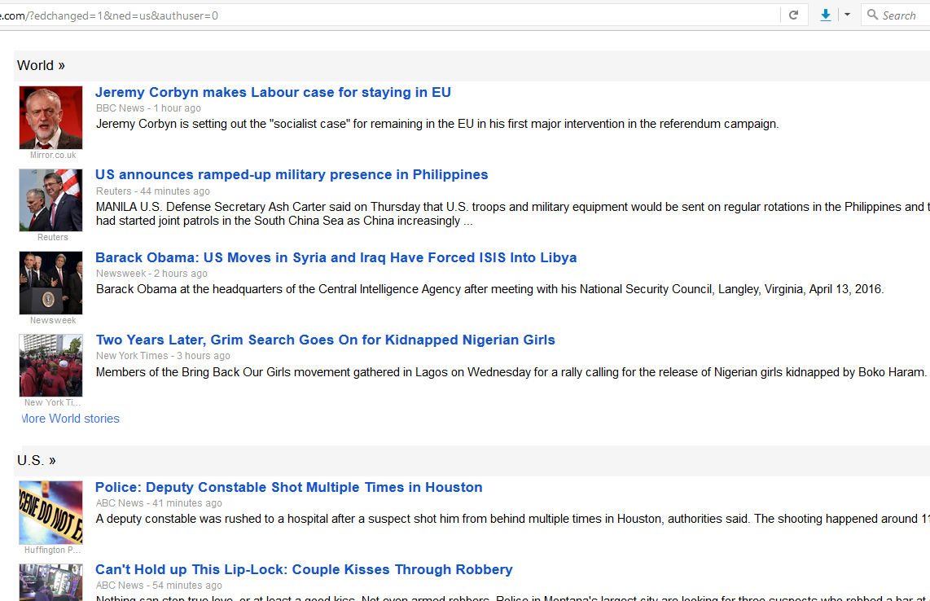
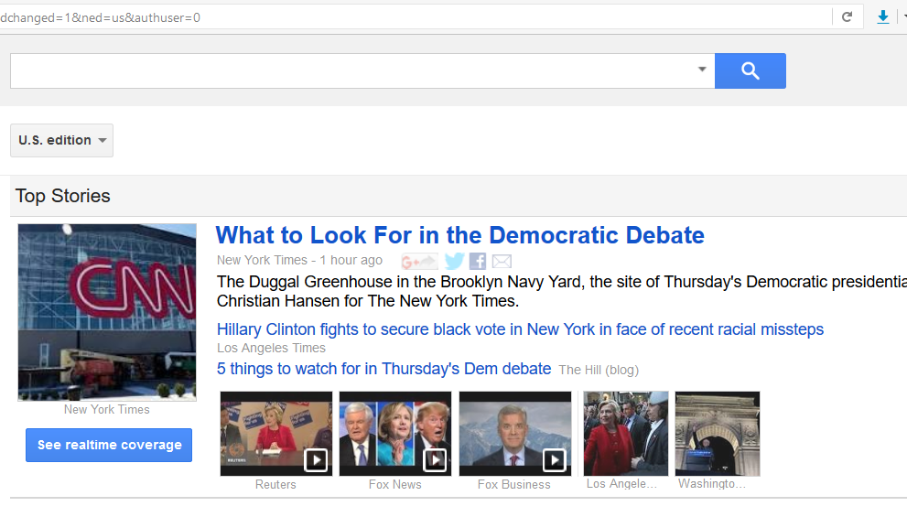
Steps 3 and 4: Identify the Problem Type and Learning Model
Some examples of supervised and unsupervised learning models are:
Concept
Problem Types
Example
Supervised Learning
Unsupervised Learning
Categories of news based on the topics
Grouping of similar stories on different news networks
Notes:
Google’s news makes use of both supervised and unsupervised machine learning models.
To identify and categorize news articles appropriately, Google uses a classification algorithm, which falls under the supervised machine learning model.
Now if you click a particular news within a category, it will show you all the related stories from different news media and channels. This grouping is done by clustering, which is an unsupervised learning algorithm.

Slide 14





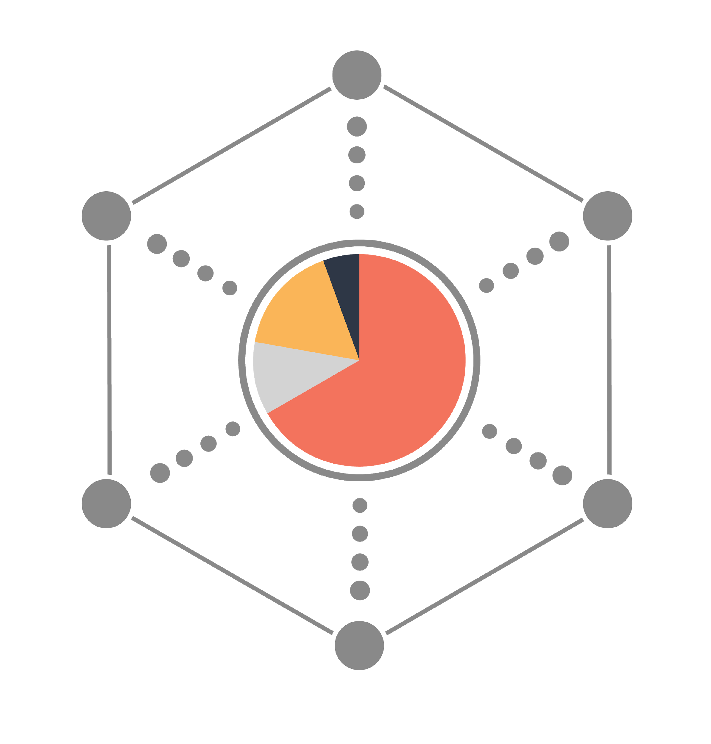

Working of Supervised Learning Model
In supervised learning, a known dataset with observations, features, and response is used to create and train a machine learning algorithm. A predictive model, built on top of this algorithm, is then used to predict the response for a new dataset that has the same features.
Known Data
New or Unseen Data
Observations/ Records
Observations/ Records
Features/ Attributes
Predictive
Model
Features/ Attributes
Response/ Label
Machine
Learning
Algorithm
Predicted Response/Label
Notes:
Before you look at the next steps of the machine learning approach, let’s understand how supervised and unsupervised learning models work.
A known dataset has observations, which include features and response. In supervised learning, the features and response are fed into the appropriate machine learning algorithm to train it. After the algorithm is fine tuned, a predictive model is built on top of it. Any new or unseen data with the same features will not have a label or a response attached to it. The model is used to predict the response for this data.

Slide 15
Working of Unsupervised Learning Model
In unsupervised learning, a known dataset has a set of observations with features. But the response is not known. The predictive model uses these features to identify how to classify and represent the data points of new or unseen data.
Known Data
New or Unseen Data
Observations/ Records
Observations/ Records
Features/ Attributes
Machine
Learning
Algorithm
Predictive
Model
Features/ Attributes
Data Representation
Notes:
In unsupervised learning, a known dataset has a set of observations with features. But the response or outcome is not known. Without the knowledge of what the expected outcome should be for a given set of data points, the machine learning algorithm cannot be taught to predict the outcome for any new dataset. But, you do know what the features are of a given dataset. Based on this information and your domain expertise, you can choose a few assumptions that will help you to define the features or attributes the algorithm should watch out for. This helps it identify, classify, and visually represent any new or unseen data. You can also use cross-validation to further test and train the model and improve its accuracy.

Slide 16
Steps 5 and 6: Train, Test, and Optimize the Model
To train supervised learning models, data analysts usually divide a known dataset into training and testing sets.
Supervised Learning
Unsupervised Learning
Known Data
Known Data
Observations/ Records
Observations/ Records
Features/ Attributes
Features/ Attributes
Response/ Label
Notes:
The last two steps of the Machine Learning Approach involve testing, training, and optimizing the model.
Only supervised learning models can be trained because all the “right” features, and labels or responses are already known. In unsupervised learning, the machine algorithm looks for similarities based only on statistical properties.
There are two approaches to train the supervised learning model:
The first approach is to use two separate datasets, one to train the model and the other to test it. The second approach is to split a single dataset into two parts: a training set and a testing set.
Data analysts prefer the split approach because the algorithm uses the same set of data points for training and testing, and they can change from one iteration to other.
The test set usually makes up some twenty to forty percent of the original dataset. The split approach gives greater accuracy when it comes to predicting the unknowns.

Slide 17
Steps 5 and 6: Train, Test, and Optimize the Model
Known Data
Train
(60%-80%)
Test
(20%-40%)
Observations/ Records
Features/ Attributes
Response/ Label
Machine
Learning
Algorithm
Notes:
The last two steps of the Machine Learning Approach involve testing, training, and optimizing the model.
Only supervised learning models can be trained because all the “right” features, and labels or responses are already known. In unsupervised learning, the machine algorithm looks for similarities based only on statistical properties.
There are two approaches to train the supervised learning model:
The first approach is to use two separate datasets, one to train the model and the other to test it. The second approach is to split a single dataset into two parts: a training set and a testing set.
Data analysts prefer the split approach because the algorithm uses the same set of data points for training and testing, and they can change from one iteration to other.
The test set usually makes up some twenty to forty percent of the original dataset. The split approach gives greater accuracy when it comes to predicting the unknowns.

Slide 18
Steps 5 and 6: Train, Test, and Optimize the Model
Let us look at an example to see how the split approach works.
Model Training
Observation
Response
ID | Education | Professional training | Hourly rate
10 | 16 | 1 | 90
45 | 15 | 0 | 65
83 | 12 | 1 | 70
45 | 18 | 1 | 130
54 | 16 | 0 | 110
67 | 16 | 1 | 100
71 | 15 | 1 | 105
31 | 15 | 0 | 70
Train set
Train set
Test set
Test set
Notes:
To better understand how the split approach works, let’s go back to the same records belonging to the XYZ firm.
Looking at the records, you can see that it contains continuous data. Hence, it requires the regression algorithm under the supervised learning model. Your next step is to find the attributes which affect the outcome. Since employee ID does not affect the outcome, you can drop it from the set. Use 5 of the records for training, and the rest 3 for testing. This would split the dataset into 37.5% test data and 62.5% train data.
The response is also split into testing and training sets.
This whole approach helps achieve greater accuracy for response predictions.

Slide 19
Supervised Learning Model Considerations
Some considerations of supervised and unsupervised learning models are shown here.
Performance optimization
Response
Model
Accuracy
Features
Generalization
Notes:
While designing the supervised learning model, consider the following:
Response and the features which directly affect the outcome feed the machine algorithm and model directly.
Fine tune the parameters of the model, based on the training and testing results, to optimize its performance and accuracy. This will help you to scale up the model easily.
Generalization means “predicting the response.” Strive for a model which can predict consistently.

Slide 20
Scikit-Learn

Slide 21






Scikit-Learn
Scikit is a powerful and modern machine learning Python library for fully and semi-automated data analysis and information extraction.
Efficient tools to identify and organize problems
(Supervised/ Unsupervised)
Free and open datasets
Rich set of libraries for learning and predicting
Model support for every problem type
Model persistence
Open source community and vendor support
Notes:
Scikit is a powerful and modern machine learning Python library. It is a great tool for fully and semi-automated advanced data analysis and information extraction.
There are a lot of reasons why Scikit-Learn is a preferred machine learning tool:
It has efficient tools to identify and organize problems, such as whether it fits the supervised or unsupervised learning model.
It contains many free and open datasets.
It has a rich set of built-in libraries for learning and predicting.
It provides model support for every problem type.
It also has built-in functions, such as pickle, for model persistence.
It is supported by a huge open source community and vendor base.

Slide 22
Scikit-Learn: Problem-Solution Approach
Scikit-learn helps Data Scientists organize their work through its problem-solution approach.
Model Selection
Estimator Object
Model Training
Predictions
Model Tuning
Accuracy
Notes:
Scikit-learn helps Data Scientists organize their work through its problem-solution approach. This involves:
Choosing the model and machine algorithm based on the dataset type,
Using the “estimator” object, which represents the model in Scikit-Learn, by importing the class and instantiating it,
Fitting the data into the model to train and test it,
Using the “predict method” to forecast the response of unseen or new dataset,
Tuning the model through multiple iterations and result observations,
Finally, striving for accuracy using built-in methods that support the predictive model.

Slide 23
Scikit-Learn: Problem-Solution Considerations
While working with a Scikit-Learn dataset or loading your own data to Scikit -Learn, always consider these points:
✔
Create separate objects for feature and response
✔
Ensure that features and response have only numeric values
✔
Features and response should be in the form of a NumPy ndarray
✔
Since features and response would be in the form of arrays, they would have shapes and sizes
✔
Features are always mapped as x, and response is mapped as y
Notes:
While working with a Scikit-Learn dataset or loading your own data to SciKit learn, always consider these four points:
Create separate objects for feature and response.
Ensure that features and response have only numeric values.
Features and response should be in the form of a NumPy ndarray.
Since features and response would be in the form of arrays, they would have shapes and sizes.
Features are always mapped as X and response is mapped as Y.

Slide 24
Supervised Learning Models: Linear Regression

Slide 25
Supervised Learning Models: Linear Regression
Linear regression is a supervised learning model used to analyze continuous data.
It is easy to use as the model does not require a lot of tuning
It is the most basic and widely used technique to predict a value of an attribute
It runs very fast, which makes it more time-efficient
Notes:
Linear regression is the most basic and widely used technique to predict a value of an attribute. It’s rather easy to use as the model doesn’t require a lot of tuning. It also runs very fast, which makes it more time-efficient.

Slide 26
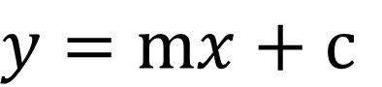
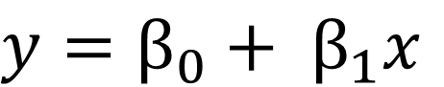
Supervised Learning Models: Linear Regression
The linear regression equation is based on the formula for a simple linear equation.
Simple linear equation
Linear regression equation
Response
Input features
Intercept
Coefficient of x
Notes:
The first equation that you see here is a simple linear equation from linear algebra. The linear regression formula is derived from it, where “y” is the response and “x”’ is the input feature. Beta zero is the intercept of the line, which equals the value of the response variable when the input feature or predictor is zero.
Beta one is the coefficient of “x.” It is also called the slope parameter. It corresponds to the change in the response variable, given a 1 unit change in the predictor variable.
Scikit-Learn has a built-in linear regression model and we’ll be using that for linear regression machine learning.

Slide 27
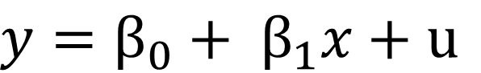
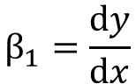
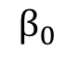
Supervised Learning Models: Linear Regression
Linear regression is the most basic technique to predict a value of an attribute.
Data point
Residual
y
(response)
Residual
Least square line
dy
dx
(0, y)
Slope/ gradient
Actual value
Predicted value
x (predictor variable)
!
The attributes are usually fitted using the “least square” approach.
Notes:
The variable “u,” called the residual value, comprises other factors which affect the prediction but are not included in the model.
The regression line or the least square line is the line of best fit.
Beta 1 is the slope of the line.
Beta zero is the value of “y” when “x” is equal to zero.
Residual value equals the difference between the actual value and the predicted value of “y,” which means that it equals the distance between a data point and the least square line.

Slide 28
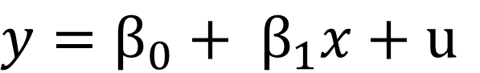
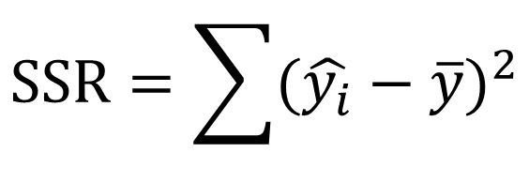
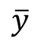
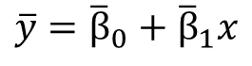
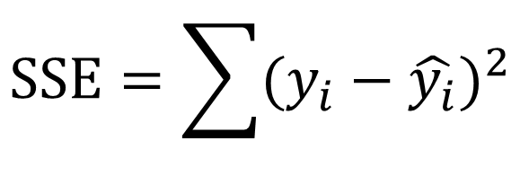
Supervised Learning Models: Linear Regression
Smaller the value of SSR or SSE, the more accurate the prediction will be, which would make the model the best fit.
Data point
y
(response)
SSE
Least square line
SSR
Regression of sum of squares
(0, y)
x (predictor variable)
Error of sum of squares
!
The attributes are usually fitted using the “least square” approach.
Notes:
The variable “y” bar indicates that the slope of the regression line is zero and the intercept is the sample mean of the response variable.
SSR (or the regression of the sum of squares) indicates the difference between the regression line and the mean of the response variable. The variability is explained by the model.
SSE (or the error of sum of squares) indicates the difference between the observed value and the regression line. This is the case where the amount of variability is unexplained by the model.
So, smaller the value of SSR or SSE, the more accurate the prediction will be, which would make the model the best fit.

Slide 29
Supervised Learning Models: Linear Regression
Let us see how linear regression works in Scikit-Learn.
Normalizes the regression variable before performing the regression operation
Calculates the intercept for this model
Class
sklearn.linear_model.LinearRegression(fit_intercept=True, normalize=False, copy_X=True, n_jobs=1)
Copies the regression variable
Number of jobs to use for the computation
Notes:
Let’s see how linear regression algorithm works in SciKit-learn
Scikit-learn has a class called linear regression. It has to be instantiated by creating an object, also called an estimator.
If the Boolean variable ‘fit_intercept’ is true, it calculates the intercept of the model.
When the Boolean variable ‘Normalize’ is true, it normalizes the regression variable before performing the regression operation.
If ‘Copy_x’ is true, then the regression variable is copied; else it will be overwritten and the default value is held true.
N_jobs specifies the number of jobs that are to be computed in parallel.

Slide 30
Loading a Dataset
Problem Statement: Demonstrate how to load a built-in SciKit-learn dataset.
Access: Click on the Practice Labs tab on the left side panel of the LMS. Copy or note the username and password that is generated. Click on the Launch Lab button. On the page that appears, enter the username and password in the respective fields, and click Login.
Notes:
Notes to the instructor:
Please demonstrate the steps to load an in-built SciKit-learn dataset.

Slide 31
Linear Regression Model
Problem Statement: Demonstrate how to create and train a linear regression model
Access: Click on the Practice Labs tab on the left side panel of the LMS. Copy or note the username and password that is generated. Click on the Launch Lab button. On the page that appears, enter the username and password in the respective fields, and click Login.
Notes:
Notes to the instructor:
Please demonstrate the steps to create and train a linear regression model.

Slide 32
Supervised Learning Models: Logistic Regression

Slide 33
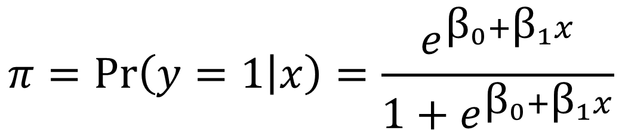

Supervised Learning Models: Logistic Regression
Logistic regression is a generalization of the linear regression model used for classification problems.
Probability of y = 1, given x
Change in the log-odds for a unit change in x
The purpose of K-NN is to predict the class for each observation.
Notes:
Logistic regression algorithms are mainly used for categorical data.
We use a set of input features to predict the probabilities of class membership. In simpler terms, this means that the algorithm predicts the class of each observation present in the dataset.
The above equation is the simplest logistic function used for performing logistic regression.

Slide 34
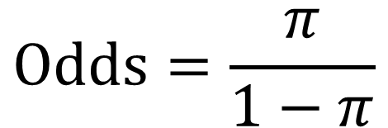
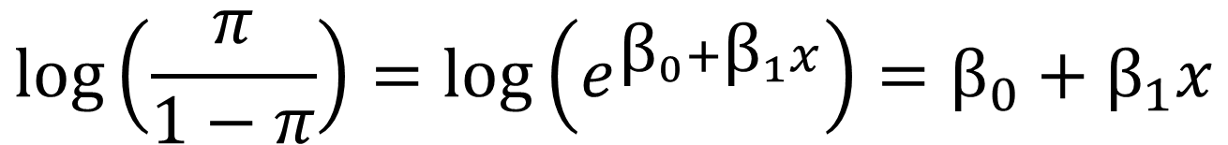
Supervised Learning Models: Logistic Regression
Logistic regression is a generalization of the linear regression model used for classification problems.
Probability
Logarithm of odds
Linear regression
Notes:
To interpret the outputs of a logistic function, we must understand the difference between probability and odds.
The odds of an event is the ratio of the probability of the event by its complement. One interesting observation here is that if you take the logarithm of odds, it becomes linear regression. So the data generalization switches from categorical to regression.

Slide 35
Supervised Learning Models: Logistic Regression
Inverse of regularization
Specifies the norm used in penalization
Calculates the intercept
Implemented only for L2 penalty
Class
class sklearn.linear_model.LogisticRegression(penalty='l2', dual=False, tol=0.0001, C=1.0, fit_intercept=True, intercept_scaling=1, class_weight=None, random_state=None, solver='liblinear', max_iter=100, multi_class='ovr', verbose=0, warm_start=False, n_jobs=1)
Seed or the random state instance
Algorithm to use in the optimization problem
If true, reuse the solution of the previous call
Number of jobs in parallel computation
Can be ovr (binary) or multinomial
Notes:
Let’s see how logistic regression works in SciKit-learn.
SciKit learn has a class called logistic regression. It has to be instantiated by creating an object, also called an estimator.
There can be two types of algorithms:
First is OvR (or, One Vs rest). It is most suitable for binary problems.
The second algorithm type is ‘multinomial’, which has multi class.
‘Penalty’ is used to specify the norm used in the penalization. The newton-cg and lbfgs solvers support only L2 penalties.
‘Dual’ is implemented only for an L2 penalty.
‘C’ is the inverse of regularization.
‘Fit_intercept’ calculates the intercept.
If the Boolean variable ‘warm_start’ is true, then the algorithm reuses the solution of the previous call.
‘N_jobs’ specifies the number of jobs in parallel computation.
‘Random_state’ is the seed or the random state instance.
‘Liblinear’ is the algorithm to be used in the optimization problem.
Multi-class specifies whether the algorithm is ‘ovr’ (or binary) or ‘multinomial’.

Slide 36
Supervised Learning Models: : K-Nearest Neighbors

Slide 37
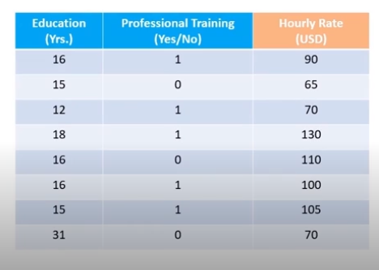
Supervised Learning Models: K-Nearest Neighbors (K-NN)
K-Nearest Neighbors, or K-NN, is one of the simplest machine learning algorithms used for both classification and regression problem types.
Features
(Attributes)
Notes:
K-nearest neighbors, or K-NN, is one of the simplest machine learning algorithms used for both classification and regression problem types.
This algorithm uses the entire training dataset to create its model. It looks at the inputs or features of the training dataset to identify the attributes of any new or unseen data. Based on how similar a data point is to an attribute (or in simpler terms, how near it is to the input data point), the algorithm classifies it.
Imagine we have two Classes in our training set: Class A (represented by red circles) and Class B (represented by blue circles).
Let’s mark a new unseen data point as a green circle.
Now to classify it, we just expand a specific distance away from our feature space until we hit “k” number of other data points.
Here, you can see the differences between various k values.
If you are using this method for binary classification, choose an odd number for k to avoid the case of a "tied" distance between two classes.
In this example, for “k” equals three, the green data point picks 3 closest data points, represented by the yellow region.
And, for “k” equals 6, the green data point picks 6 closest data points, shown within the blue region.

Slide 38
Supervised Learning Models: K-Nearest Neighbors
K=6
K=3
If you are using this method for binary classification, choose an odd number for k to avoid the case of a tied distance between two classes.
Notes:
K-nearest neighbors, or K-NN, is one of the simplest machine learning algorithms used for both classification and regression problem types.
This algorithm uses the entire training dataset to create its model. It looks at the inputs or features of the training dataset to identify the attributes of any new or unseen data. Based on how similar a data point is to an attribute (or in simpler terms, how near it is to the input data point), the algorithm classifies it.
Imagine we have two Classes in our training set: Class A (represented by red circles) and Class B (represented by blue circles).
Let’s mark a new unseen data point as a green circle.
Now to classify it, we just expand a specific distance away from our feature space until we hit “k” number of other data points.
Here, you can see the differences between various k values.
If you are using this method for binary classification, choose an odd number for k to avoid the case of a "tied" distance between two classes.
In this example, for “k” equals three, the green data point picks 3 closest data points, represented by the yellow region.
And, for “k” equals 6, the green data point picks 6 closest data points, shown within the blue region.

Slide 39
Supervised Learning Models: K-Nearest Neighbors
K-means finds the best centroids by alternatively assigning random centroids to a dataset and selecting mean data points from the resulting clusters to form new centroids. It continues this process iteratively until the model is optimized.
Features
(Attributes)
Response
(label)
Notes:
K-nearest neighbors, or K-NN, is one of the simplest machine learning algorithms used for both classification and regression problem types.
This algorithm uses the entire training dataset to create its model. It looks at the inputs or features of the training dataset to identify the attributes of any new or unseen data. Based on how similar a data point is to an attribute (or in simpler terms, how near it is to the input data point), the algorithm classifies it.
Imagine we have two Classes in our training set: Class A (represented by red circles) and Class B (represented by blue circles).
Let’s mark a new unseen data point as a green circle.
Now to classify it, we just expand a specific distance away from our feature space until we hit “k” number of other data points.
Here, you can see the differences between various k values.
If you are using this method for binary classification, choose an odd number for k to avoid the case of a "tied" distance between two classes.
In this example, for “k” equals three, the green data point picks 3 closest data points, represented by the yellow region.
And, for “k” equals 6, the green data point picks 6 closest data points, shown within the blue region.

Slide 40
K-NN and Logistic Regression Models
Problem Statement: Demonstrate the use of K-NN and logistic regression models
Access: Click on the Practice Labs tab on the left side panel of the LMS. Copy or note the username and password that is generated. Click on the Launch Lab button. On the page that appears, enter the username and password in the respective fields, and click Login.
Notes:
Notes to the instructor:
Please demonstrate the steps to use K-NN and logistic regression models

Slide 41
Unsupervised Learning Models: Clustering

Slide 42
Unsupervised Learning Models: Clustering
A cluster is a group of similar data points.
Clustering is used to:
Extract the structure of the data
Identify groups in the data
Greater similarity between data points results in better clustering.
Notes:
Clustering is the way to group similar data points. It helps extract the structure of the data and identify its groups. By looking at the diagram, it is very obvious that a greater similarity between the data points results in better clustering.

Slide 43
Unsupervised Learning Models: K-Means Clustering
K-means finds the best centroids by alternatively assigning random centroids to a dataset and selecting mean data points from the resulting clusters to form new centroids. It continues this process iteratively until the model is optimized.
Centroids (mean)
Assign
Optimize
Find the number of clusters and assign mean
Iterate and optimize the mean for each cluster for its respective data points
Notes:
Consider a scenario where you are given a dataset where each observed example has a set of features but has no labels or response attached to it.
So in the absence of a response, you can identify which data points in a dataset are similar. Each similar group of data points is called a cluster.
K-means, one of the most popular "clustering" algorithms, stores “k” centroids which are used to define clusters. A point is considered to be in a particular cluster if it’s closer to that cluster's centroid than any other centroid.
Now let’s see how the “k-means” algorithm works. You have to first understand the dataset, make some assumptions about it based on your domain expertise, and then feed those assumptions to the algorithm. Based on those inputs, k-means randomly assigns a specific number of centroids to a dataset. It assigns data points to the centroids, depending on their proximity to them. Once the data points are grouped separately, k-means chooses a data point that is in the center of each group. It then re-assigns data points to these new centroids, based on their proximity. If this creates a new set of groups, then k-means again chooses a data point from the center of each group to form centroids. It repeats this process again and again until the model is optimized.

Slide 44
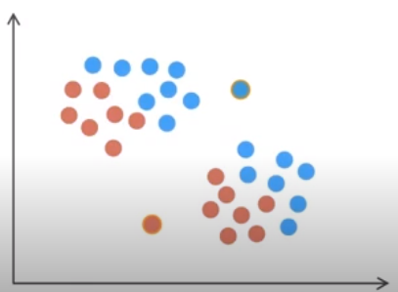
Unsupervised Learning Models: K-Means Clustering
K-means finds the best centroids by alternatively assigning random centroids to a dataset and selecting mean data points from the resulting clusters to form new centroids. It continues this process iteratively until the model is optimized.
Assign data points to the centroids
Notes:
Consider a scenario where you are given a dataset where each observed example has a set of features but has no labels or response attached to it.
So in the absence of a response, you can identify which data points in a dataset are similar. Each similar group of data points is called a cluster.
K-means, one of the most popular "clustering" algorithms, stores “k” centroids which are used to define clusters. A point is considered to be in a particular cluster if it’s closer to that cluster's centroid than any other centroid.
Now let’s see how the “k-means” algorithm works. You have to first understand the dataset, make some assumptions about it based on your domain expertise, and then feed those assumptions to the algorithm. Based on those inputs, k-means randomly assigns a specific number of centroids to a dataset. It assigns data points to the centroids, depending on their proximity to them. Once the data points are grouped separately, k-means chooses a data point that is in the center of each group. It then re-assigns data points to these new centroids, based on their proximity. If this creates a new set of groups, then k-means again chooses a data point from the center of each group to form centroids. It repeats this process again and again until the model is optimized.

Slide 45
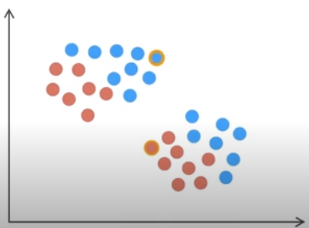
Unsupervised Learning Models: K-Means Clustering
Choose a mean from each cluster as a centroid
Notes:
Consider a scenario where you are given a dataset where each observed example has a set of features but has no labels or response attached to it.
So in the absence of a response, you can identify which data points in a dataset are similar. Each similar group of data points is called a cluster.
K-means, one of the most popular "clustering" algorithms, stores “k” centroids which are used to define clusters. A point is considered to be in a particular cluster if it’s closer to that cluster's centroid than any other centroid.
Now let’s see how the “k-means” algorithm works. You have to first understand the dataset, make some assumptions about it based on your domain expertise, and then feed those assumptions to the algorithm. Based on those inputs, k-means randomly assigns a specific number of centroids to a dataset. It assigns data points to the centroids, depending on their proximity to them. Once the data points are grouped separately, k-means chooses a data point that is in the center of each group. It then re-assigns data points to these new centroids, based on their proximity. If this creates a new set of groups, then k-means again chooses a data point from the center of each group to form centroids. It repeats this process again and again until the model is optimized.

Slide 46
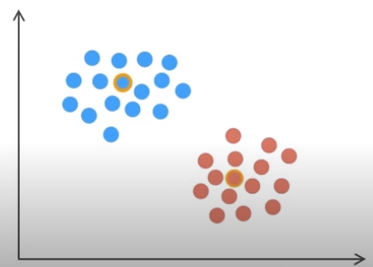
Unsupervised Learning Models: K-Means Clustering
Reassign data points to new centroids
Notes:
Consider a scenario where you are given a dataset where each observed example has a set of features but has no labels or response attached to it.
So in the absence of a response, you can identify which data points in a dataset are similar. Each similar group of data points is called a cluster.
K-means, one of the most popular "clustering" algorithms, stores “k” centroids which are used to define clusters. A point is considered to be in a particular cluster if it’s closer to that cluster's centroid than any other centroid.
Now let’s see how the “k-means” algorithm works. You have to first understand the dataset, make some assumptions about it based on your domain expertise, and then feed those assumptions to the algorithm. Based on those inputs, k-means randomly assigns a specific number of centroids to a dataset. It assigns data points to the centroids, depending on their proximity to them. Once the data points are grouped separately, k-means chooses a data point that is in the center of each group. It then re-assigns data points to these new centroids, based on their proximity. If this creates a new set of groups, then k-means again chooses a data point from the center of each group to form centroids. It repeats this process again and again until the model is optimized.

Slide 47
Unsupervised Learning Models: K-Means Clustering
Iterate the process till the model is optimized
Notes:
Consider a scenario where you are given a dataset where each observed example has a set of features but has no labels or response attached to it.
So in the absence of a response, you can identify which data points in a dataset are similar. Each similar group of data points is called a cluster.
K-means, one of the most popular "clustering" algorithms, stores “k” centroids which are used to define clusters. A point is considered to be in a particular cluster if it’s closer to that cluster's centroid than any other centroid.
Now let’s see how the “k-means” algorithm works. You have to first understand the dataset, make some assumptions about it based on your domain expertise, and then feed those assumptions to the algorithm. Based on those inputs, k-means randomly assigns a specific number of centroids to a dataset. It assigns data points to the centroids, depending on their proximity to them. Once the data points are grouped separately, k-means chooses a data point that is in the center of each group. It then re-assigns data points to these new centroids, based on their proximity. If this creates a new set of groups, then k-means again chooses a data point from the center of each group to form centroids. It repeats this process again and again until the model is optimized.

Slide 48
Unsupervised Learning Models: K-Means Clustering
Let us see how the k-means algorithm works in Scikit-Learn.
Number of clusters to form and number of centroids to generate
Number of times the K-means algorithm will be run with different centroid seeds
Pre-compute for faster operation
Class
Selects initial cluster centers
sklearn.cluster.KMeans(n_clusters=8, init='k-means++', n_init=10, max_iter=300, tol=0.0001, precompute_distances='auto',
verbose=0, random_state=None, copy_x=True, n_jobs=1)
Maximum number of iterations of the K-means algorithm for a single run
Initialize the centers
Number of jobs in parallel computation
If true, does not modify data while pre-computing
Notes:
Let’s see how k-means algorithm works in Scikit-Learn.
Scikit-learn has a Class called k-means. It has to be instantiated by creating an object, also called an estimator.
Let’s take a closer look at the signature of the class.
N_cluster gives the number of clusters and centroids that are to be formed.
init = k-means++ selects initial cluster centers.
n_init specifies the number of times the k-means algorithm will be run with different centroid seeds.
max_iter specifies the maximum number of iterations of the k-means algorithm for a single run.
precompute_distances is used to pre-compute the algorithm for a faster operation.
random_state initializes the centers.
If the copy_x argument is true, then the algorithm will not modify the data while it carries out the pre-computation.
N_jobs specifies the number of jobs to be run in parallel.

Slide 49
K-Means Clustering
Problem Statement: Demonstrate how to use k-means clustering to classify data points.
Access: Click on the Practice Labs tab on the left side panel of the LMS. Copy or note the username and password that is generated. Click on the Launch Lab button. On the page that appears, enter the username and password in the respective fields, and click Login.
Notes:
Notes to the instructor:
Please demonstrate the steps to use k-means clustering to classify data points.

Slide 50
Unsupervised Learning Models: Dimensionality Reduction

Slide 51
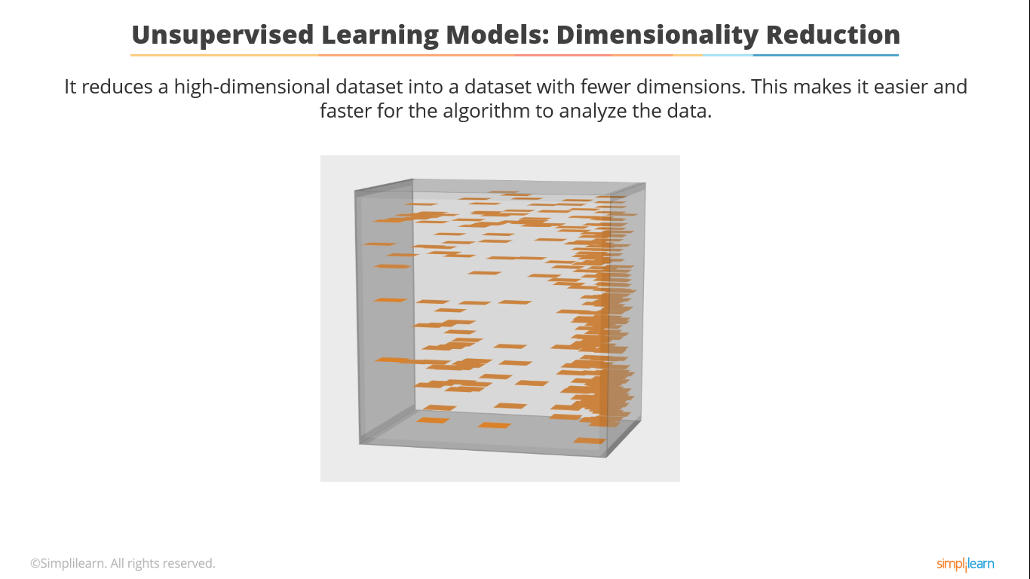
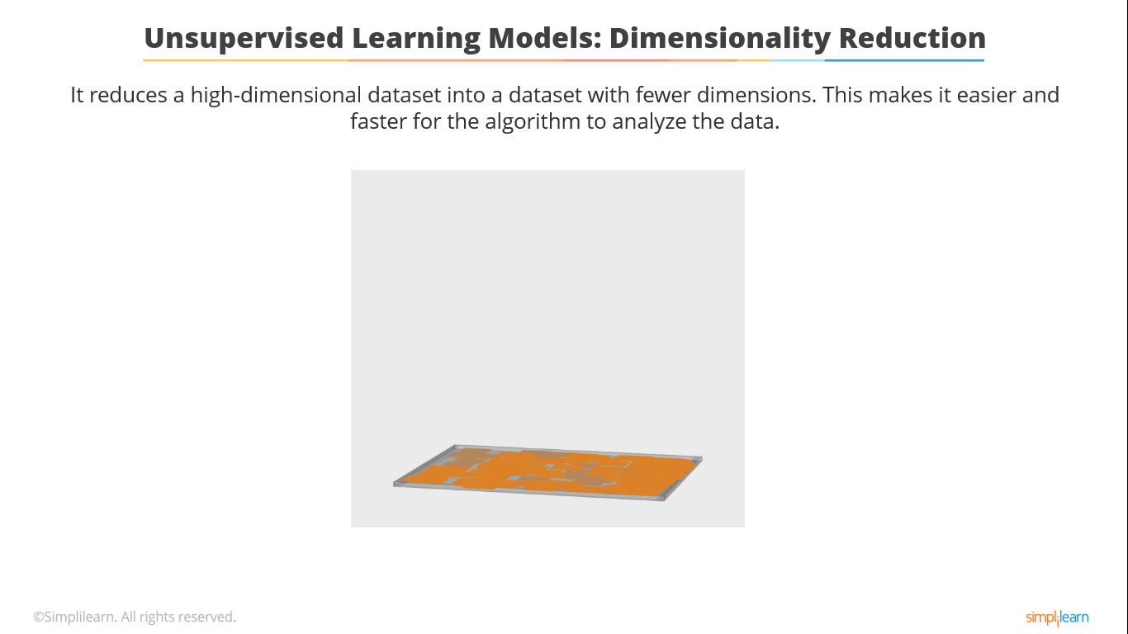
Unsupervised Learning Models: Dimensionality Reduction
It reduces a high-dimensional dataset into a dataset with fewer dimensions. This makes it easier and faster for the algorithm to analyze the data.
Notes:
A large dataset can have multiple dimensions. When you have a multi-dimensional dataset, you need a lot of data points to create its representative sample. If you have to perform an analytics operations on it, the performance would be very slow and sluggish.
For example, just imagine a large spreadsheet with a few thousand rows and a few thousand columns. You definitely want to trim down the spreadsheet for faster computation.
To do that, you might want to drop off a few columns from the dataset without losing the information it contains because that might lead to a wrong analysis.
This is where dimensionality reduction comes into play. It helps cut down the dimensions of a multi-dimensional dataset without losing any of the data.

Slide 52
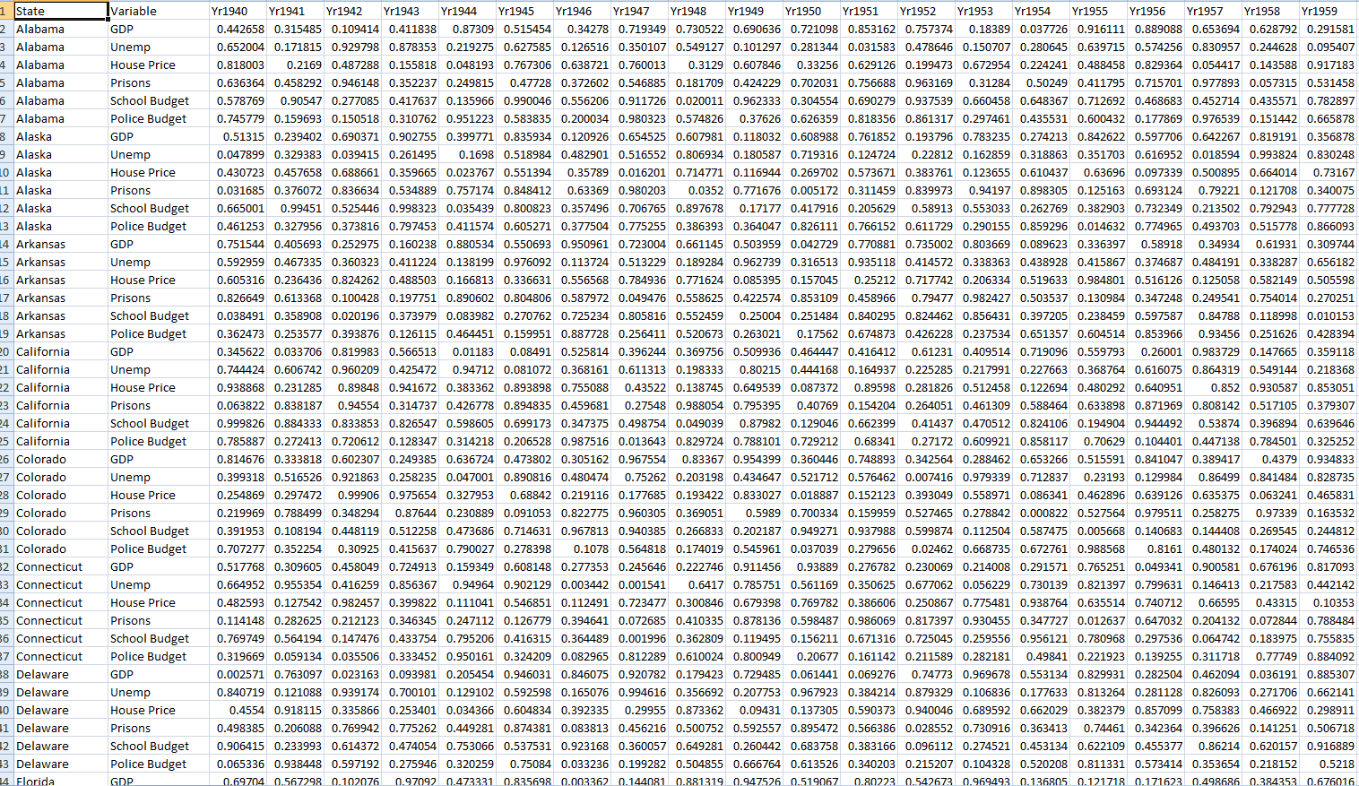
Unsupervised Learning Models: Dimensionality Reduction
These are some techniques used for dimensionality reduction:
Drop data columns with missing values
Drop data columns with low variance
Drop data columns with high correlations
Large dataset
(a few thousand columns and rows)
Apply statistical functions - PCA
Notes:
Let’s now look at the different techniques for dimensionality reduction:
The first method is to drop the columns which contain missing values and exceed some defined threshold value for the dataset.
Data variance indicates the changes in the data value. So, if there are small changes in the data, then you can choose to remove data lower than a defined threshold after normalizing it.
Correlation indicates how data points are related to each other. If they are highly correlated, only one set of data points can be kept while others can be dropped.
Principal Component Analysis, or PCA, is a statistical function which transforms the original datasets into a new set of coordinates by keeping the highest possible variance to ensure there is a significant loss in data.

Slide 53
Unsupervised Learning Models: Principal Component Analysis

Slide 54
Unsupervised Learning Models: Principal Component Analysis (PCA)
It is a linear dimensionality reduction method which uses singular value decomposition of the data and keeps only the most significant singular vectors to project the data to a lower dimensional space.
It is primarily used to compress or reduce the data.
PCA tries to capture the variance, which helps it pick up interesting features.
PCA is used to reduce dimensionality in the dataset and to build our feature vector.
Here, the principal axes in the feature space represents the direction of maximum variance in the data.
Minor axis
Principal axis
This method is used to capture variance.
Notes:
Principal Component Analysis, or PCA, is one of the most used unsupervised learning algorithms.
It is primarily used to compress or reduce the data. This functionality also helps it to carry out dimensionality reduction.
PCA tries to capture the variance, which helps it pick up interesting features. That’s why it’s useful as a feature extraction method.
In short, we can use PCA to reduce dimensionality in the dataset and to build our feature vector.
In the above diagram, the principal axes in the feature space represents the direction of maximum variance in the data.

Slide 55
Unsupervised Learning Models: Principal Component Analysis
Let us look at how the PCA algorithm works in Scikit-Learn.
Number of components to keep
Class
sklearn.decomposition.PCA(n_components=None, copy=True, whiten=False)
Overwrites the transform data after fitting them into the model
Removes data with lower variance
Notes:
This slide shows you how the PCA algorithm works in Scikit-Learn. Recall that PCA helps reduce the dimensions of a dataset by keeping only the significant singular vectors.
Scikit-learn’s PCA class has to be instantiated by creating an object, also called an estimator.
Let’s take a closer look at the signature of the class.
“N_components” indicates the number of components that should be retained. If this variable is not set, then all the components are retained.
“Copy” overwrites the “transform data” after fitting it into the model. It is not used frequently because we don’t often need to overwrite the transform data.
“Whiten” simply removes the data with lower variance and improves the prediction accuracy.

Slide 56
Principal Component Analysis (PCA)
Problem Statement: Demonstrate how to use the PCA model to reduce the dimensions of a dataset.
Access: Click on the Practice Labs tab on the left side panel of the LMS. Copy or note the username and password that is generated. Click on the Launch Lab button. On the page that appears, enter the username and password in the respective fields, and click Login.
Notes:
Notes to the instructor:
Please demonstrate the steps to use the PCA model to reduce the dimensions of a dataset.

Slide 57

Pipeline
All models in the pipeline must be transformers. The last model can either be a transformer or a classifier, regressor, or other such objects.
It simplifies the process where more than one model is required or used.
Once all the data is fit into the models or estimators, the predict method can be called.
Estimators are known as ‘model instance’.
Notes:
Different estimators are used for different purposes. For instance, some estimators are used to transform data, while others are used to classify, and so on. You can combine multiple estimators to form a single, powerful estimator using an estimator pipeline.

Slide 58
Pipelines
Problem Statement: Demonstrate how to build a pipeline.
Access: Click on the Practice Labs tab on the left side panel of the LMS. Copy or note the username and password that is generated. Click on the Launch Lab button. On the page that appears, enter the username and password in the respective fields, and click Login.
Notes:
Notes to the instructor:
Please demonstrate the steps to build a pipeline containing more than one estimator.

Slide 59


Model Persistence
You can save your model for future use. This avoids the need to retrain the model.
This can be saved using the Pickle method.
It can also be replaced with the joblib of Sci-kit team.
Both joblib.dump and joblib.load can be used.
These would be efficient for Big Data.
Notes:
Once you create a model, you should be able to save it as well so that you can reuse it later. This is called model persistence.
Python uses pickle to save an object.
To save an object in scikit-learn, pickle is replaced by a special method called joblib.
Using its joblib.dump and joblib.load methods, you can read and write estimator objects. Although these methods are useful only for storing data on disk, they are highly efficient for large amounts of data.

Slide 60
Model Persistence
Problem Statement: Demonstrate how to persist a model for future use.
Access: Click on the Practice Labs tab on the left side panel of the LMS. Copy or note the username and password that is generated. Click on the Launch Lab button. On the page that appears, enter the username and password in the respective fields, and click Login.
Notes:
Notes to the instructor:
Please demonstrate the steps to persist a model for future use using scikit-learn.

Slide 61
Model Evaluation: Metric Functions
You can use the “Metrics” function to evaluate the accuracy of your model’s predictions.
Classification
metrics. accuracy_score
metrics.average_precision_score
Clustering
metrics.adjusted_rand_score
Regression
metrics.mean_absolute_error
metrics.mean_squared_error
metrics.median_absolute_error
Notes:
It’s important to evaluate a model to check and validate its quality and accuracy. Scikit-learn’s metrics function is one of the most common functions used to evaluate machine learning models. It can be used to evaluate classification, clustering, and regression-type models.
To check the quality of classification-type models, you can use the “accuracy score” and “average score” methods. For clustering, use the “adjusted random score” method.
While for regression, you can use the “mean absolute error”, “mean squared error” and “median absolute error” methods.

Slide 62
Evaluation of Dataset
Problem Statement:
The given dataset contains ad budgets for different media channels and the corresponding ad sales of XYZ firm. Evaluate the dataset to:
Find the features or media channels used by the firm
Find the sales figures for each channel
Create a model to predict the sales outcome
Split as training and testing datasets for the model
Calculate the Mean Square Error (MSE)

Slide 63
Evaluation of Dataset
Instructions to perform the assignment:
Download the FAA dataset from the “Resource” tab. Upload the dataset to your Jupyter notebook to view and evaluate it.
Common instructions:
If you are new to Python, download the “Anaconda Installation Instructions” document from the “Resources” tab to view the steps for installing Anaconda and the Jupyter notebook.
Download the “Assignment 01” notebook and upload it on the Jupyter notebook to access it.
Follow the cues provided to complete the assignment.

Slide 64
Listing the Glucose Level Readings
Problem Statement:
The given dataset lists the glucose level readings of several pregnant women taken either during a survey examination or routine medical care. It specifies if the two hours post-load plasma glucose was at least 200 mg/dl. Analyze the dataset to:
Find the features of the dataset
Find the response label of the dataset
Create a model to predict the diabetes outcome
Use training and testing datasets to train the model
Check the accuracy of the model

Slide 65
Listing the Glucose Level Readings
Instructions on performing the assignment:
Download the “pima-Indians-diabetes.DATA” and “pima-Indians-diabetes.NAMES” files from the “Resources” tab. Load the .DATA file to the Jupyter notebook to work on it.
Open the .NAMES file with a notepad application to view its text. Use this file to view the features of the dataset and add them manually in your code.
Common instructions:
If you are new to Python, download the “Anaconda Installation Instructions” document from the “Resources” tab to view the steps for installing Anaconda and the Jupyter notebook.
Download the “Assignment 02” notebook and upload it on the Jupyter notebook to access it.
Follow the provided cues to complete the assignment.

Slide 66
Key Takeaways
You are now able to:
Define machine learning
Explain the machine learning approach
List relevant terminologies that help you understand a dataset
Discuss features of supervised and unsupervised learning models
Explain algorithms, such as regression, classification, clustering, and dimensionality reduction

Slide 68
In machine learning, which one of the following is an observation?
1
Features
Attributes
Records
Labels

Slide 69
In machine learning, which one of the following is an observation?
1
Features
Attributes
Records
Labels
c
An observation is a set of examples, records, or samples.

Slide 70
If data is continuous and has labels (response), then it fits which of the following problem types?
2
Supervised learning: Classification
Unsupervised learning: Clustering
Unsupervised learning: Dimensionality reduction
Supervised learning: Regression

Slide 71
If data is continuous and has labels (response), then it fits which of the following problem types?
2
Supervised learning: Classification
Unsupervised learning: Clustering
Unsupervised learning: Dimensionality reduction
Supervised learning: Regression
d
The regression algorithm belonging to the supervised learning model is best suited to analyze continuous data.

Slide 72
Identify the goal of unsupervised learning. Select all that apply.
3
To predict the outcome
To understand the structure of the data
To generalize the dataset
To represent the data

Slide 73
Identify the goal of unsupervised learning. Select all that apply.
3
To predict the outcome
To understand the structure of the data
To generalize the dataset
To represent the data
b, d
The goal of unsupervised learning is to understand the structure of the data and represent it. There is no right or certain answer in unsupervised learning.

Slide 74
The estimator instance in Scikit-learn is a _____.
4
To predict the outcome
To understand the structure of the data
To generalize the dataset
To represent the data

Slide 75
The estimator instance in Scikit-learn is a _____.
4
Model
Feature
Dataset
Response
a
The estimator instance or object is a model.

Slide 76
What is the best way to train a model?
5
Use the entire dataset as a training and testing set both
Split the known dataset into separate training and testing sets
Ask the source to provide continuous data
Ask the source to provide categorical data

Slide 77
What is the best way to train a model?
5
Use the entire dataset as a training and testing set both
Split the known dataset into separate training and testing sets
Ask the source to provide continuous data
Ask the source to provide categorical data
b
The best way to train a model is to split the known dataset into training and testing sets. The testing set varies from 20% to 40%.

Slide 78
Which of the following is true with a greater value of SSR or SSE? Select all that apply.
6
The prediction will be more accurate, making it the best fit model.
The prediction will start becoming less accurate.
The outcome remains unaffected.
The model will not be the best fit for the attributes.

Slide 79
Which of the following is true with a greater value of SSR or SSE? Select all that apply.
6
The prediction will be more accurate, making it the best fit model.
The prediction will start becoming less accurate.
The outcome remains unaffected.
The model will not be the best fit for the attributes.
b, d
With higher SSR or SSE, the prediction will be less accurate and the model will not be the best fit for the attributes.

Slide 80
Class sklearn.linear_model.LogisticRegression, random_state _____.
7
Indicates the seed of the pseudo random number generator used to shuffle data
Defines the features state
Represents the number of random iterations
Specifies a random constant to be added to the decision function

Slide 81
Class sklearn.linear_model.LogisticRegression, random_state _____.
7
Indicates the seed of the pseudo random number generator used to shuffle data
Defines the features state
Represents the number of random iterations
Specifies a random constant to be added to the decision function
a
The class “sklearn.linear_model.LogisticRegression, random_state” indicates the seed of the pseudo random number generator used to shuffle data.

Slide 82
What are the requirements of the K-means algorithm? Select all that apply.
8
Number of clusters should be specified
More than one iteration should meet requisite criteria
Centroids should minimize inertia
Features should be labeled

Slide 83
What are the requirements of the K-means algorithm? Select all that apply.
8
Number of clusters should be specified
More than one iteration should meet requisite criteria
Centroids should minimize inertia
Features should be labeled
a, b, c
The K-means algorithm requires the number of clusters to be specified and the centroids to minimize inertia. It requires several iterations to fine tune itself and meet the required criteria to become the best fit model.

Slide 84
What are the requirements of the K-means algorithm? Select all that apply.
9
Fits the model with X and applies the dimensionality reduction on X
Transforms the data back to its original space
Applies the dimensionality reduction on X
Computes data co-variance with the generative model

Slide 85
In Class sklearn.decomposition.PCA, the transform(X) method , where X is multi-dimensional _____.
9
Fits the model with X and applies the dimensionality reduction on X
Transforms the data back to its original space
Applies the dimensionality reduction on X
Computes data co-variance with the generative model
c
In Class “sklearn.decomposition.PCA,” the transform(X) method applies the dimensionality reduction on X.

Slide 86
Thank You
Notes:
This concludes the lesson “Machine Learning with Python (Scikit-Learn)” The next lesson will discuss “Natural Language Processing (NLP) with SciKit Learn.”

